Slide 1
Introduction to Big Data
Data Exploration and Discovery

Slide 2
Review Previous Lesson

Slide 3
Review Concepts from Day 2
The following major topics were introduced last class.
Business Problem Definition
Analytics Problem Definition
Influence Diagramming
Stakeholder & Analytics Teams
Data Characteristics
Data Structure
Data Format
Data Granularity
Data Latency
Data Security
Variable Types
SQL Concepts
Data Visualization Basics

Slide 4
Lesson Review from Day 2
You should be able to answer these questions from class 2
What are the main items found in a framed business problem?
What are the main items found in a defined analytics problem?
What is the purpose of an influence diagram?
What are the critical roles found in an analytics team?
What does data granularity refer to?
What are the different types of data latency?
What are some examples of ordinal data?
What are some restrictions placed on interval and ordinal data?
What criteria could you use when selecting a visualization?
What are the main building blocks of a SQL Select statement?

Slide 5
Day 3 – New Topics Introduced
The following major topics are discussed this class.
Data exploration
Data discovery
Measurement scales
Data shape
Univariate data
Bivariate data
Descriptive statistics
Correlation
Linear relationships
Filtering techniques to query from multiple data tables from Pandas/Python

Slide 6
Learning Objectives for Day 3

Slide 7
Day 3 - Learning Objectives
During Day 3 you will learn to:
Describe and apply Exploratory Data Analysis
Concepts, Purpose and Methods
Describe properties of measurement data
By measurement scale
By data type
By measurement role
By analytical application
Explore and describe univariate data
Descriptive statistics
Visual methods
Explore and describe bivariate data
Correlations
Visual methods
Discover different types of data relationships
Linear correlations
Distributions
Apply filtering techniques and query multiple data tables from Pandas/Python

Slide 8
Exploratory Data Analysis

Slide 9
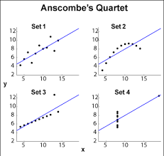
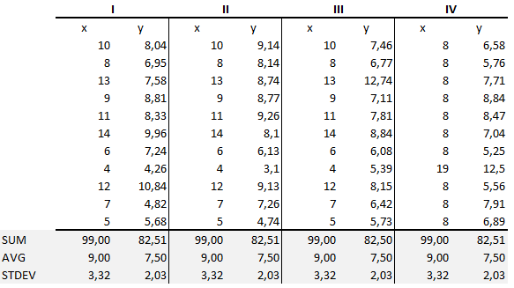
Exploratory Data Analysis Purpose
It has been shown that statistical summaries of data may not always be reliable.
Visual inspection is recommended to avoid misinformation. This example is called Anscombe’s Quartet. There are 4 data sets having the same statistics but visual inspection shows 4 distinct patterns
Review the following web site
https://en.wikipedia.org/wiki/Anscombe%27s_quartet
Four data sets with the same summary statistics but four distinctly different patterns
Visual exploration can find patterns hidden by the statistics

Slide 10
EDA and Visualization
Exploratory Data Analysis (EDA) and Visualization are very important steps in any analysis task.
get to know your data!
distributions (symmetric, normal, skewed)
data quality problems
outliers
correlations and inter-relationships
subsets of interest
suggest functional relationships
Sometimes EDA or viz might be the goal!

Slide 11
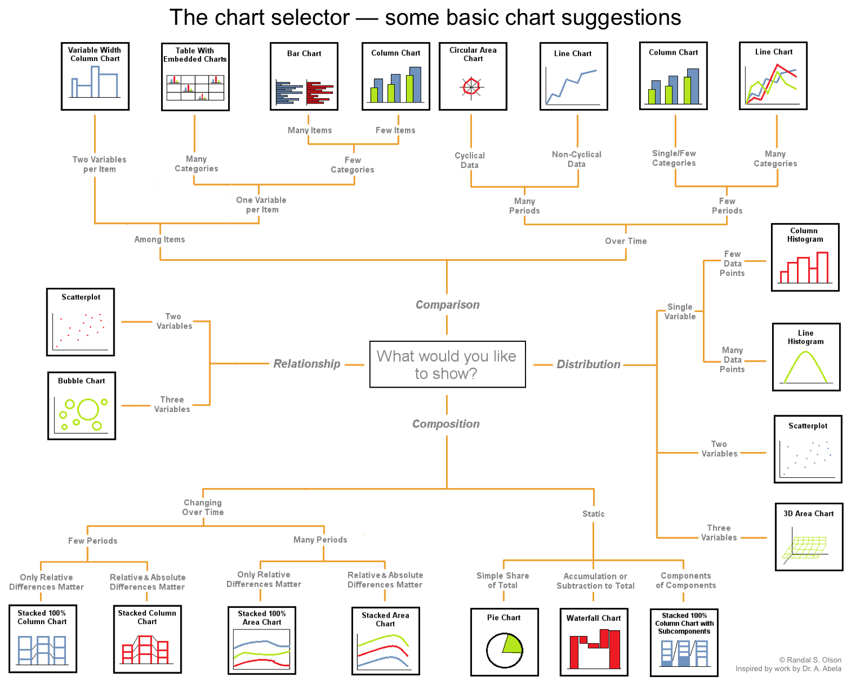
Data Visualization

Slide 12

Exploratory Data Analysis (EDA)
Goal: get a general sense of the data
means, medians, quantiles, histograms, boxplots
You should always look at every variable - you will learn something!
data-driven (model-free)
Think interactive and visual
Humans are the best pattern recognizers
You can use more than 2 dimensions!
x,y,z, space, color, time….
Especially useful in early stages of data mining
detect outliers (e.g. assess data quality)
test assumptions (e.g. normal distributions or skewed?)
identify useful raw data & transforms (e.g. log(x))
Bottom line: it is always well worth looking at your data!

Slide 13
Exploratory Data Analysis Methods
Measuring Central Tendency
Mean, median, and mode
Mean, median, and mode are different measures of center in a numerical data set. They each try to summarize a dataset with a single number to represent a "typical" data point from the dataset.
Mean: The "average" number; found by adding all data points and dividing by the number of data points.
Median: The middle number; found by ordering all data points and picking out the one in the middle (or if there are two middle numbers, taking the mean of those two numbers).
Mode: The most frequent number—that is, the number that occurs the highest number of times.

Slide 14
Exploratory Data Analysis Methods
Measuring Spread
Variance
Standard Deviation
Inter Quartile Range
If the data distribution is symmetrical all three of these statistics have the same value and any of these statistics can be used to describe the central tendency. The mean is most commonly used for this
If the data distribution is skewed or unbalanced to the left or to the right, then the median is used to describe the central tendency.
Read the following article on-line for further definitions of descriptive statistics. Following the links within the web site to see definitions for the key terms.
https://en.wikipedia.org/wiki/Descriptive_statistics

Slide 15
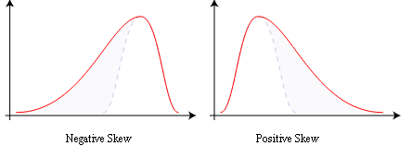
Summary Statistics
not visual
sample statistics of data X
mean: μ = ∑_{i} X_{i} / n
mode: most common value in X
median: X=sort(X), median = X_{n/2} (half below, half above)
quartiles of sorted X: Q1 value = X_{0.25n} , Q3 value = X_{0.75 n}
interquartile range: value(Q3) - value(Q1)
range: max(X) - min(X) = X_{n} - X₁
variance: σ² = ∑_{i} (X_{i} - μ)² / n
skewness: ∑_{i} (X_{i} - μ)³ / [ (∑_{i} (X_{i} - μ)²)^{3/2} ]
zero if symmetric; right-skewed more common (what kind of data is right skewed?)
number of distinct values for a variable (see unique() in R)
Don’t need to report all of thses: Bottom line…do these numbers make sense???

Slide 16
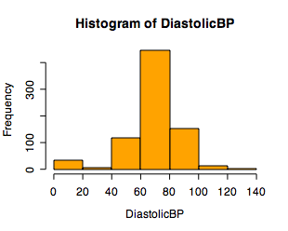
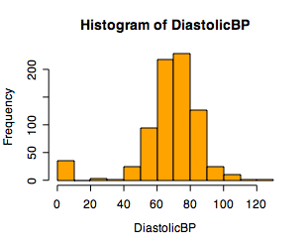
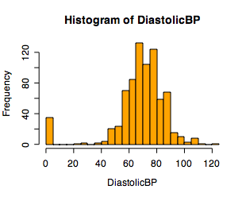
Single Variable Visualization
Histogram:
Shows center, variability, skewness, modality,
outliers, or strange patterns.
Bin width and position matter
Beware of real zeros

Slide 17
Issues with Histograms
For small data sets, histograms can be misleading.
Small changes in the data, bins, or anchor can deceive
For large data sets, histograms can be quite effective at illustrating general properties of the distribution.
Histograms effectively only work with 1 variable at a time
But ‘small multiples’ can be effective

Slide 18
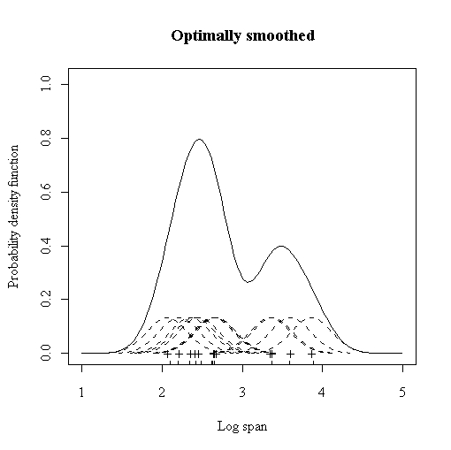
Smoothed Histograms - Density Estimates
Kernel estimates smooth out the contribution of each datapoint over a local neighborhood of that point.
h is the kernel width
Gaussian kernel is common:

Slide 19
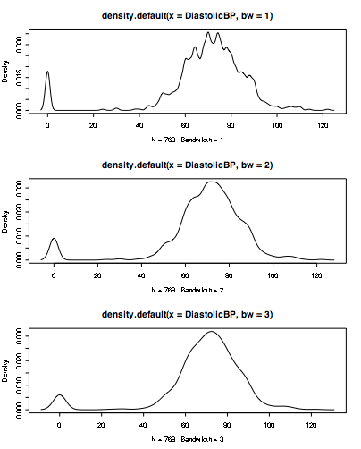
Bandwidth choice is an art
Usually want to try several

Slide 20
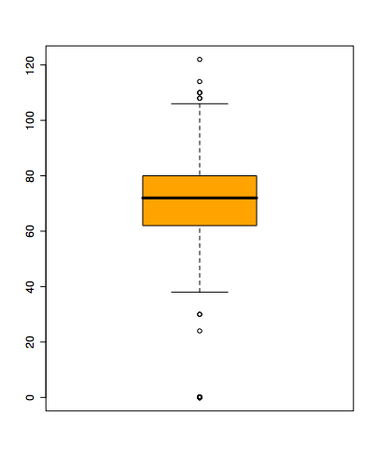
Boxplots
Shows a lot of information about a variable in one plot
Median
IQR
Outliers
Range
Skewness
Negatives
Overplotting
Hard to tell distributional shape
no standard implementation in software (many options for whiskers, outliers)
Notes:
Horizontal line in box is median (Q2)
Top and bottom of plot are always Q1 and Q3
Whiskers can mean several things: usually these are the minimum and maximum of all of the data
Values outside this range are pkptted as outliers (circles)

Slide 21
Time Series
If your data has a temporal component, be sure to exploit it
summer bifurcations in air travel
(favor early/late)
summer
peaks
steady growth
trend
New Year bumps

Slide 22
Time-Series Example 3
mean weight vs mean age
for 10k control group
Scotland experiment:
“↑ milk in kid diet → better health” ?
20,000 kids:
5k raw, 5k pasteurize,
10k control (no supplement)
Possible explanations:
Grow less early in year than later?
No steps in height plots; so why
height ↑ uniformly, weight ↑ spurts?
Kids weighed in clothes: summer garb lighter than winter?
Would expect smooth weight growth plot.
Visually reveals
unexpected pattern (steps),
not apparent from raw data table.

Slide 23
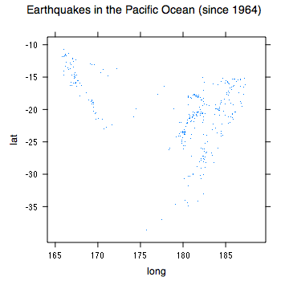
Spatial Data
If your data has a geographic component, be sure to exploit it
Data from cities/states/zip cods – easy to get lat/long
Can plot as scatterplot

Slide 24
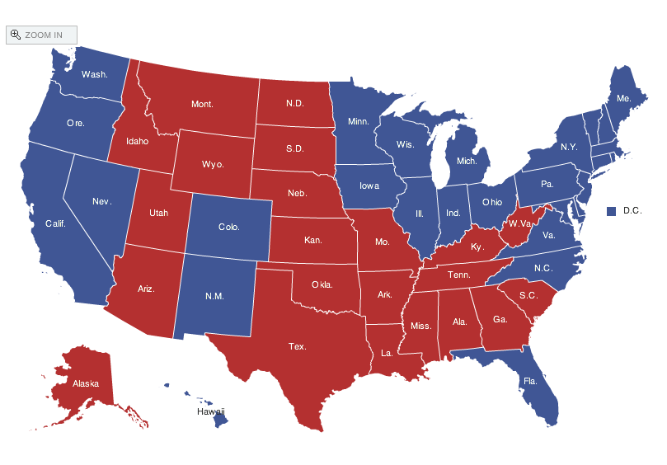
Spatial data: choropleth Maps
Maps using color shadings to represent numerical values are called choropleth maps
http://elections.nytimes.com/2008/results/president/map.html

Slide 25
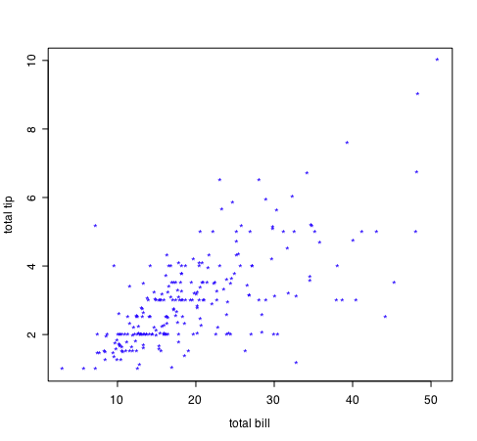
Two Continuous Variables
For two numeric variables, the scatterplot is the obvious choice
interesting?
interesting?

Slide 26
2D Scatterplots
useful to answer:
x,y related?
linear
quadratic
other
variance(y) depend on x?
outliers present?
standard tool to display relation between 2 variables
e.g. y-axis = response, x-axis = suspected indicator
interesting?
interesting?

Slide 27
Exploratory Data Analysis Methods
Univariate non-graphical methods
The goal of this method to answer 2 basic questions about the values of a single numerical variable. The data set is called a sample data distribution
How similar are the values to each other?
How different are the values from each other?
The first question is answered with an understanding of the “central tendency” of the data. How the values cluster around a common value is key to understanding the “similarity” property in the data.
The second question is answered with an understanding of the “spread” or “dispersion of the data. How much the values differ the “central tendency” value provides an understanding of the “difference” property in the data.
Common descriptive values calculated include
Center (central tendency)
Spread
Modality (number of peaks in the data)
Shape
Outliers.

Slide 28
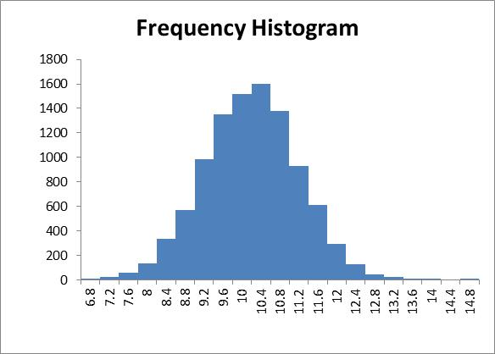
Exploratory Data Analysis Examples
Example 1 – Symmetrical Sample Distribution

Slide 29
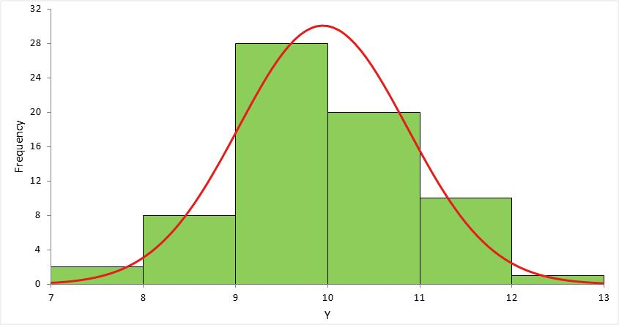
Exploratory Data Analysis Examples
Example 2 – Symmetrical Distribution

Slide 30
Measurement Data

Slide 31
Properties of Measurement Data
Overview
Measurements are data elements that quantify a property of interest to us.
The four types of measurement scales (and related variables) were introduced last Day.
The following link provides a tutorial on measurement scales. Watch the video and read the content on the website that describes the four measurement scales.
http://stattrek.com/statistics/measurement-scales.aspx?Tutorial=AP

Slide 32
Measurement Data Scales
Ratio Measurement Scales
The zero point on the ratio scale is meaningful and not arbitrary. It means the “absence” of something.
Values plotted on a ratio scale are continuous and numerical. The implication of this scale is that 2 properties can be determined.
Proportion and Difference Example:
comparing a=5.0 and b=10.0
conclusion 1 – b is twice as large as a
conclusion 2– b is 5.0 units greater than a

Slide 33
Measurement Data Scales
Interval Measurement Scales
The zero point on the interval scale is not meaningful and is arbitrary. It does not mean the “absence” of something. An example is a temperature scale. Zero on the Fahrenheit or Celsius scale does NOT mean the absence of energy.
Values plotted on an interval scale are continuous and numerical. The implication of this scale is that only 1 property can be determined.
Difference example:
comparing a=5.0 and b=10.0
conclusion 1 – b is twice as large as a
it is incorrect to conclude anything about proportion on an interval scale

Slide 34
Measurement Data Scales
Ordinal Measurement Scales
The ordinal scale is used to rank items in terms of some measured criteria. An example is the five star hotel rating scheme. The only conclusion that is valid relates to the order. Conclusions about difference or proportion are incorrect.
Values plotted on an ordinal scale are rank values, scores or counts. The implication of this scale is that only 1 property can be determined.
Rank example:
comparing a=5.0 and b=10.0
conclusion 1 – b is better than a
it is incorrect to conclude anything about proportion or difference on an ordinal scale

Slide 35
Measurement Data Scales
Nominal Measurement Scales
The nominal scale is used to count and aggregate items in defined categories.
Values plotted on an nominal scale are whole to part measurements. The only conclusion that is valid states how many items are in a defined category
Nominal example:
comparing a=5.0 and b=10.0
conclusion 1 – b has 10 units and a has 5 units
it is also correct to make conclusion about differences and proportions

Slide 36
Univariate Data

Slide 37
Univariate Data Concepts
Numerical Data
Variables that measure the properties of things
Depending on the measurement technique, the can be based on ratio, interval, ordinal or nominal scales.
Categorical Data
Variables that describe things
Categorical data provides the grouping criteria used to create a nominal measurement.
Also called dimensions

Slide 38
Univariate Data Concepts
Types of Data Exploration Analysis
Numerical Data
non-graphical
graphical
Categorical Data
non-graphical counts
graphical

Slide 39
Numerical Data – Non Graphical Technique
Numerical Data Descriptive Statistics (non-graphical)
Symmetry
Shape
Height
Shape
Central Tendency
Spread
The data describes elapsed times (min) of a sample of commercial airline flights
Read the following article on-line for further definitions of descriptive statistics. Following the links within the web site to see definitions for the key terms.
https://en.wikipedia.org/wiki/Descriptive_statistics

Slide 40
Numerical Data – Non Graphical Methods
Numerical Data Descriptive Statistics Example:
The data describes departure delay times (min) of a sample of commercial airline flights.
https://www.kaggle.com/usdot/flight-delays

Slide 41
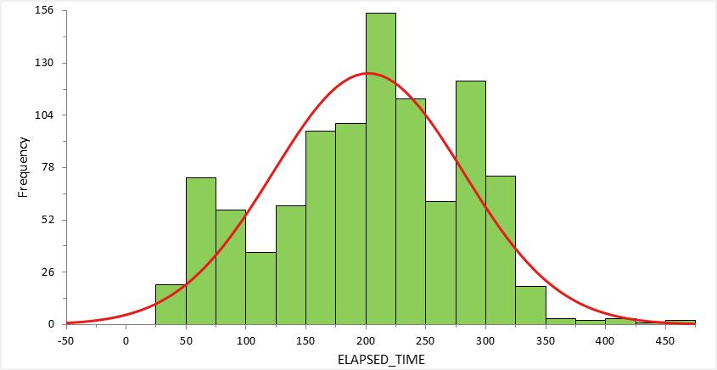
Numerical Data – Graphical Technique
Frequency Histogram with an Overlay of a Symmetrical Distribution
The data describes elapsed times (min) of a sample of commercial airline flights.
https://www.kaggle.com/usdot/flight-delays

Slide 42
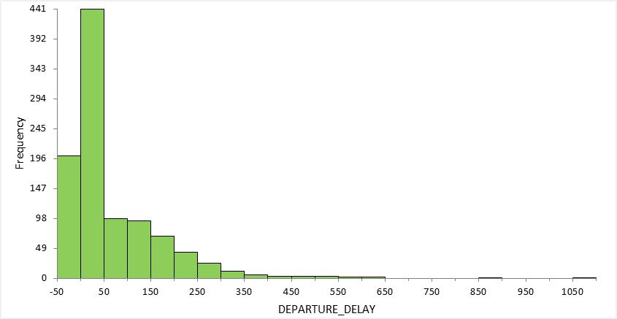
Numerical Data – Graphical Technique
Continuous Data – Frequency Histogram Example
The data describes departure delay times (min) of a sample of commercial airline flights.
https://www.kaggle.com/usdot/flight-delays

Slide 43
Numerical Data – Box Plot Technique
Box Plots also called Box-Whisker Plots are described in the following video. Please watch the video to gain an introduction to the technique.
https://www.khanacademy.org/math/statistics-probability/summarizing-quantitative-data/box-whisker-plots/v/box-and-whisker-plot-exercise-example

Slide 44
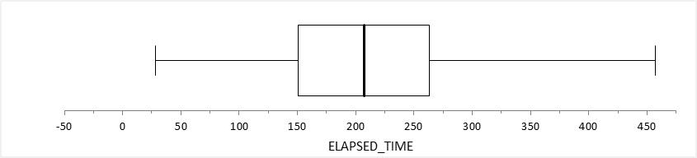
Numerical Data – Box Plot Example
Box Plot Used to Describe Central Tendency and Spread
Q3
third
quartile
Q1
first
quartile
Minimum
Median
Maximum
The data describes elapsed times (min) of a sample of commercial airline flights.
https://www.kaggle.com/usdot/flight-delays

Slide 45
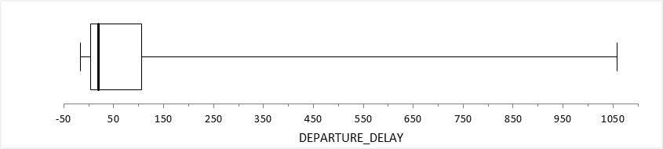
Numerical Data – Box Plot Example
Continuous Data – Box Plot Example Used to Visualize Central Tendency & Spread
The data describes departure delay times (min) of a sample of commercial airline flights.
https://www.kaggle.com/usdot/flight-delays

Slide 46
Numerical Data – Probability Distributions
Distribution functions are created from univariate analysis defined by shape, central tendency and spread.
Please watch the video in this link to gain an introduction to how distribution functions are used to model probabilities.
https://www.khanacademy.org/math/statistics-probability/modeling-distributions-of-data/density-curve/v/density-curves

Slide 47
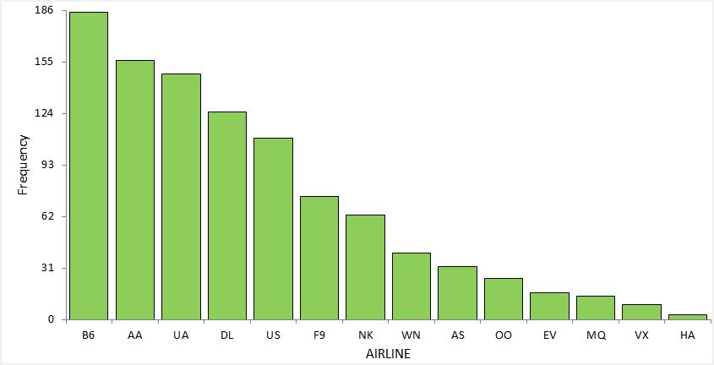
Categorical Data Exploration
Categorical Data – Absolute Frequency Example
The data describes the frequency of different airlines in the flight delay data set.
https://www.kaggle.com/usdot/flight-delays

Slide 48
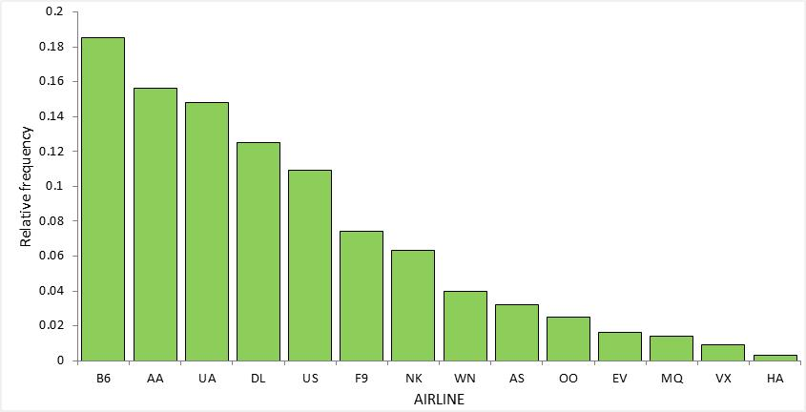
Categorical Data Exploration
Categorical Data – Relative Frequency Example
The data describes the relative frequency of different airlines in the flight delay data set.
https://www.kaggle.com/usdot/flight-delays

Slide 49
Bivariate Data

Slide 50
Bivariate Data – Scatter Plots & Correlations
Scatter plots are a useful method for starting your analysis of bivariate data.
Please watch the following video for an introduction to the technique.
https://www.khanacademy.org/math/statistics-probability/describing-relationships-quantitative-data/introduction-to-scatterplots/v/constructing-scatter-plot
Correlation coefficients measure dependencies between two variables.
Please watch the following video for an introduction to correlations.
https://www.khanacademy.org/math/statistics-probability/describing-relationships-quantitative-data/scatterplots-and-correlation/v/correlation-coefficient-intuition-examples

Slide 51
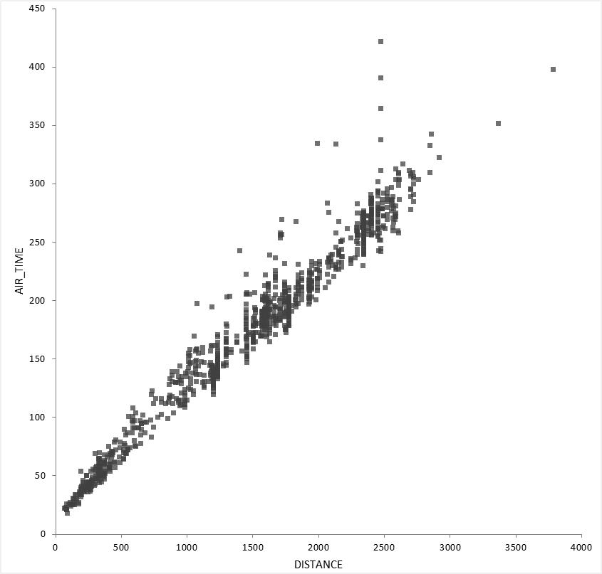
Bivariate Data Scatter Plot Example
Scatter Plot with High Positive Correlation

Slide 52
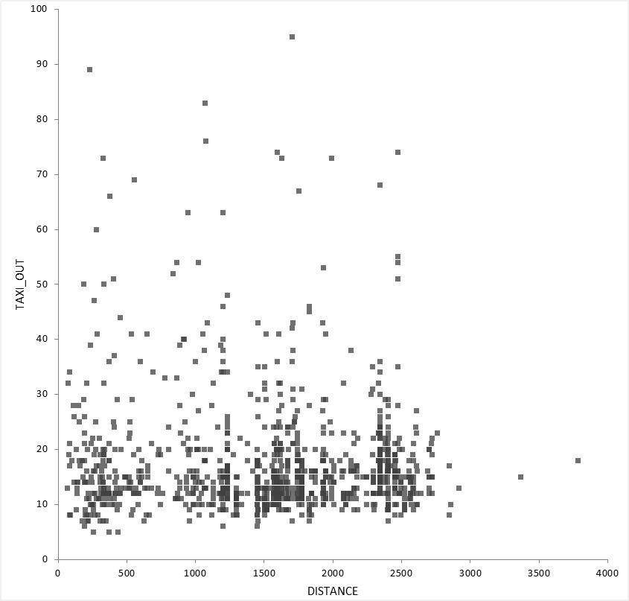
Bivariate Data Scatter Plot Example
Scatter Plot with Low Correlation

Slide 53
Lesson Review
Consider the following questions that you should be able to answer by completing Day 3.
What is the scope of data exploration?
What properties of data are discovered using data exploration?
What conclusions can be made about two different measurements from a ratio scale?
What is an example of an invalid conclusion about two different measurements from an interval scale?
What descriptive statistics are used to describe the shape of data?
What property of univariate data describes similarity?
What property of bivariate data is used to describe dependencies?
What properties of univariate data is expressed in a box plot visual?

Slide 54
Lesson Summary

Slide 55
Day 3 Lesson Summary
During Day 3 you learned to:
Identify, interpret and correctly apply categories of measurement data
Ordinal
Nominal
Interval
Ratio
Interpret descriptive statistics to quantitatively describe the shape of a variable
Central tendency measures
Dispersion measures
Skewness and Kurtosis “height” measures
Understand and describe bivariate data set according to:
Scatter plots.
Linear relationships
Correlations from a scatter plot
Correlation coefficient
Understand basic Data Exploratory methods to develop Probability Distributions
Probability Density
Data Relationships
Data Frequency Distributions
Apply filtering techniques and query from multiple data tables from Pandas/Python

